Slide 1

Enterprise Week 2019
Deirdre O’Neill, Senior Regional Development Executive
Notes:
What I intend to do this morning is outline the context, that is, what Enterprise Ireland is about, give a high level overview of our services and give a flavour of the type of supports offered.

Slide 2
Enterprise Ireland
5,000 Irish owned businesses
Start, innovate & scale through exports
All sectors of manufacturing & internationally traded services
All stages of company life-cycle from micro-enterprise (through Local Enterprise Offices) to large multi-national companies
Range of supports to match ambition at every stage
Mandate to drive commercialisation of state-funded research
FDI in food and Education in Ireland
10 offices in Ireland, 33 international offices
Connecting Irish companies to global buyers in diversified

Slide 3
Delivering Global Ambition – Our Strategy to Deliver
2017-2020
Exports
Jobs
New R&D
Spend in Economy
  €26bn p.a.
  +€5bn
  67% outside UK
  +60,000
  new jobs created
  Sustain 200,000
  existing jobs
  €1.25bn
  p.a.
  +50% in R&D spend
  €27bn p.a.
  +€4bn
Notes:
In 2017 we set the following targets around Exports, Jobs, R&D spend and increasing spending in the economy

Slide 4
Record levels of Employment Growth in every region
Employment
Growth overall
+4.4%
North
West
+9%
North
East
+3%
West
+5%
Midlands
+4%
61%
of growth in employment
Outside Dublin
Dublin
+5%
Mid East
+2%
Mid West
+5%
South East
+5%
South
+2%

Slide 5
Employment Growth in key Sectors
↑ 7%
Electronics
↑ 8%
Construction
↑ 8%
LifeSciences
↑ 3%
Food
↑ 5%
Primary
Meats
↑ 3%
ICT
↑ 5%
Engineering

Slide 6
Why is this important? Generating National and Regional wealth
Enterprise Ireland
€26.8 bn EI Clients Spend in the Economy in 2017
+7%
Services
26.8
25.0
6.1
Payroll
8.5
Payroll
(32%)
€26.8 bn
Materials
& Services
(68%)
12.2
Materials
2016
2017

Slide 7

Key sectors of strength in the Irish economy
Indigenous and
foreign direct
investment
Education
Business and
consumer services
Food
Information and communication technologies
Life sciences
and medtech
Construction
Financial services

Slide 8
Our clients
High Potential Start-ups (HPSU)
Established SMEs
Multinationals
High-growth enterprises
Potential exporters
Research community

Slide 9

How we work with clients
People & Management
Innovation
Strategy
Sales & Marketing
Finance
Operations
Strategy development
Funding support
Export assistance
Access to market-led R&I
Leadership & management development
Ecosystem development

Slide 10
Support for Start Ups in Ireland ….. Based on stage of development
1. Ideation
Supports to launch your business idea.
3. Validation
4. Getting Investor Ready
5. Growth & Scale
Developing a minimum viable product for an identified market
Seek investment, early sales & building a management team
Accelerating growth in international markets
2. Concept
Develop business plan, mission & milestones
New Frontiers Programme
A national entrepreneur development programme, delivered by Institutes of Technology and funded by Enterprise Ireland – supports include Mentoring; Office Space and €15k tax free scholarship
Paragraph
LOCAL ENTERPRISE OFFICE (LEO)
Less than 10 not seeking equity investment
LOCAL ENTERPRISE OFFICE (LEO)
Working in partnership with Enterprise Ireland are 31 dedicated teams across Ireland to assist entrepreneurs, early stage promoters, start-ups and small business looking to expand. Supports include Feasibility Grants; Mentors; training programmes and Priming / Business Expansion Grants
Enterprise Ireland HPSU
Developing Irish start-ups with the capability to scale internationally at an accelerated pace
Start
Mentor; Development Programs;
€15k grant;Market Research Centre; €50k Equity Investment
Accelerate
C€250k Equity Investment; Overseas Office Support; Grants
Founders Forum

Slide 11
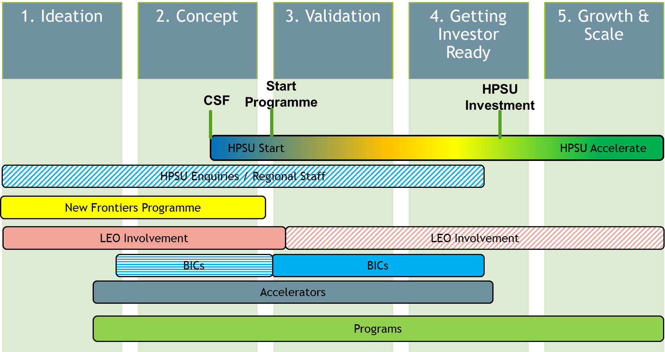
When does a start up come in………………
Prospecting & Stakeholder engagement

Slide 12
Entrepreneur Development
New Frontiers:
Ireland’s National entrepreneur development programme, delivered at local level by the Institutes of Technology.
Objective:
Accelerate the development of entrepreneurs and the creation of sustainable new businesses across the region.

Slide 13
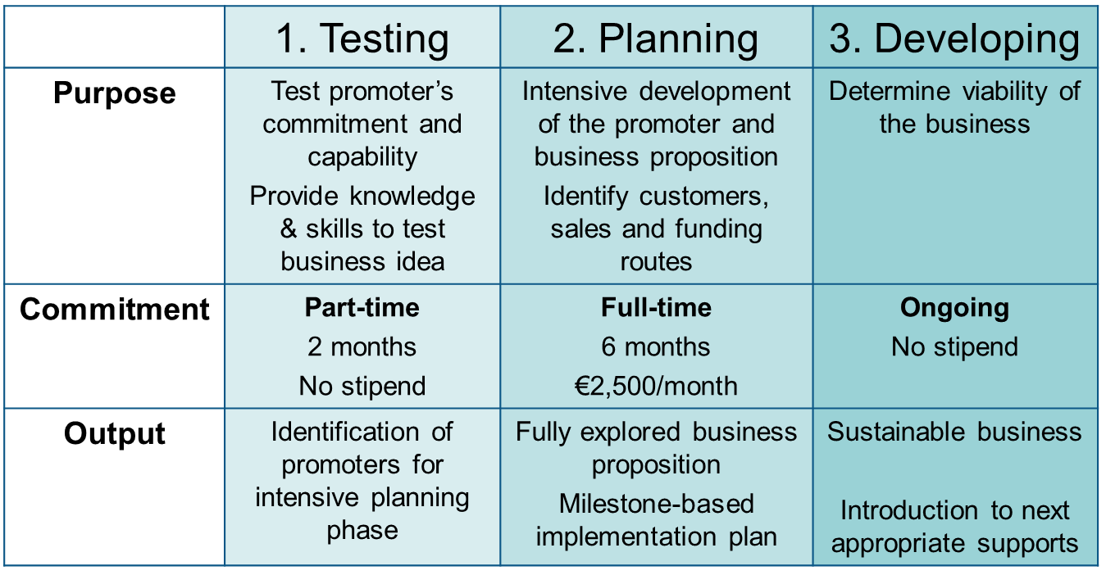
New Frontiers - Entrepreneurship Development Programme

Slide 14
Innovation Voucher
€5,000 available to assist a company or companies to explore a business opportunity or problem with a registered knowledge provider.
Max. 3 vouchers (1 a 50-50 co-funded Fast Track voucher).
Open calls for standard vouchers check website
50-50 co-funded Fast Track Applications - may be submitted anytime
Check website for conditions, Dates and listed colleges
Please note that Innovation Vouchers are EXCLUSIVE OF VAT. You will be charged VAT by the knowledge provider and this cost MUST be settled separately by the company.
Notes:
Innovation Vouchers can be used for any kind of innovation such as:
new product/process development;
new business model development;
new service delivery and customer interface;
new service development;
tailored training in innovation management;
innovation/technology audit.

Slide 15
Permitted uses for voucher
Innovation Vouchers can be used for any kind of innovation such as:
new product/process development;
new business model development;
new service delivery and customer interface;
new service development;
tailored training in innovation management;
innovation/technology audit.

Slide 16
Innovation Vouchers
Call Schedule - Open Calls for Standard Innovation Voucher Applications in 2019
Opening Date | Closing Date
Wednesday 9th January,2019 | Wednesday 23rd January, 2019 at 3pm
Wednesday 1st May, 2019 | Wednesday 15th May, 2019 at 3pm

Slide 17
Supporting the Development of
High Potential Start Up (HPSU) Companies
The company must be :
Recently established – Less than 5 years old
Innovative (operating in a growth sector)
Capable of generating at least :
  10 full time jobs (in Ireland) – in 3-4 years
  Annual revenues of €1m – in 3-4 years
International sales focus
Headquartered & controlled in Ireland
With Strong Management Team

Slide 18
HPSU Funding
Enterprise Ireland works with promoters and 3rd parties to jointly fund a start up
business plan against agreed milestones.
Early Stage HPSU: €15k Feasibility Grant for HPSU (max 50%)
Market Validation/ €50k Starter Equity , Competitive Start Fund
Prototype Development: with €5k matching funds - 10% Ordinary Shares
First Round/ Investor Ready €100k - €350k (average €250k) Equity,
CCRPs for HPSU generally fully matched
EI Funding will not be greater than combined promoters or
3rd party investment.
EI ordinary shareholding will not exceed 10% of the total company
ordinary shares.

Slide 19
Competitive Start Funds Calls 2019
Call No | Call Name | Call Open | Call Close
No. 59 | All Sectors | 29th Jan. 2019 | 12th Feb. 2019
No. 60 | CSF Call | 16th April 2019 | 30th April 2019
No. 61 | CSF Call | 02nd July 2019 | 16th July 2019
No. 62 | CSF Call | 01st October 2019 | 15th October 2019

Slide 20

https://www.enterprise-ireland.com/
Contact:
Deirdre O’Neill
Senior Region Development Executive
Dublin Region
T: 727 2145

